Slide 1
PHY 711 Classical Mechanics and Mathematical Methods
10-10:50 AM MWF Olin 103
Plan for Lecture 24:
Rigid body rotational motion (Chap. 5)
Torque free
Euler angles
Motion of a symmetric top

Slide 5
Comment about Exam problem #1:

Slide 6
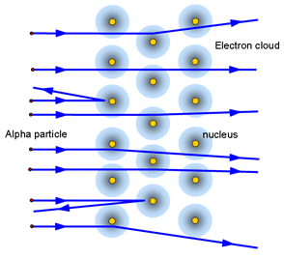
Motivation for model:
Au target particles consist of
Au nuclei which are screened by electrons.
http://tap.iop.org/atoms/rutherford/img_full_47190.gif

Slide 9
Back to rotational motion

Slide 10
Descriptions of rotation about a given origin -- continued

Slide 13
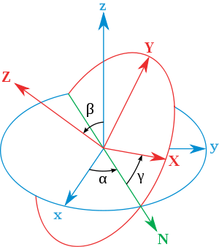
Transformation between body-fixed and inertial coordinate systems – Euler angles
inertial
body
x
y
y
x
http://en.wikipedia.org/wiki/Euler_angles

Slide 14
x
Need to express all components in body-fixed frame:
y
y
x

Slide 15
x
y
y
x

Slide 18
x
y
y
x

Slide 19
Rotational kinetic energy

