Slide 1
PHY 711 Classical Mechanics and Mathematical Methods
10-10:50 AM MWF Olin 103
Plan for Lecture 18:
Finish reading Chapter 4 and start reading Chapter 7
Coupled motion for extended systems; relationship to continuum models
Wave equation

Slide 3
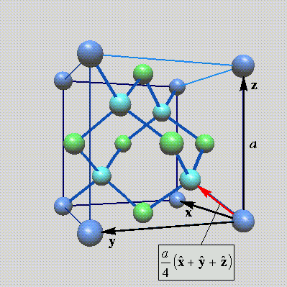
Lattice vibrations for 3-dimensional lattice
Example: diamond lattice
Ref: http://phycomp.technion.ac.il/~nika/diamond_structure.html

Slide 6
B. P. Pandy and B. Dayal, J. Phys. C. Solid State Phys. 6 2943 (1973)
Note: Longitudinal, transverse, and combination modes occur.

Slide 7
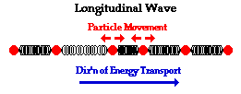
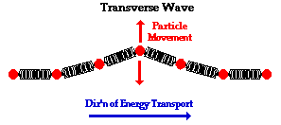
Longitudinal versus transverse vibrations
Images from web page:
http://www.physicsclassroom.com/class/waves/u10l1c.cfm

Slide 8
Longitudinal case: a system of masses and springs:
m
m
m

Slide 9
system parameter with units of (velocity)²

Slide 10
Transverse displacement:
τ
μ(x,t)

