Slide 1
PHY 711 Classical Mechanics and Mathematical Methods
10-10:50 AM MWF Olin 103
Plan for Lecture 10:
Continue reading Chapter 3 & 6
Summary & review
Lagrange’s equations with constraints

Slide 3
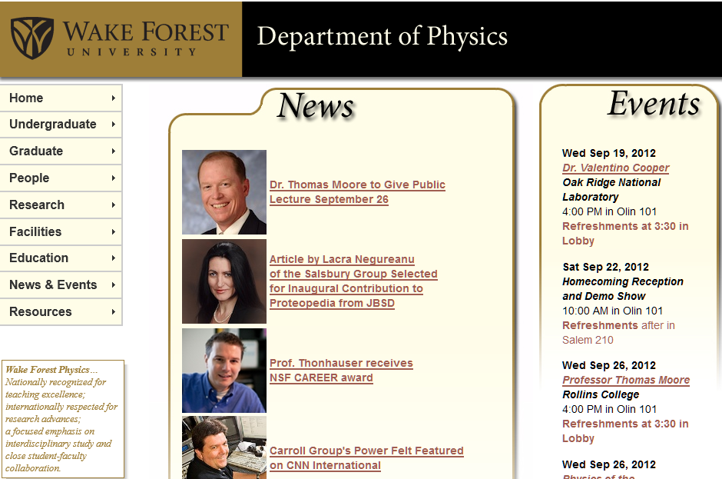

Slide 5
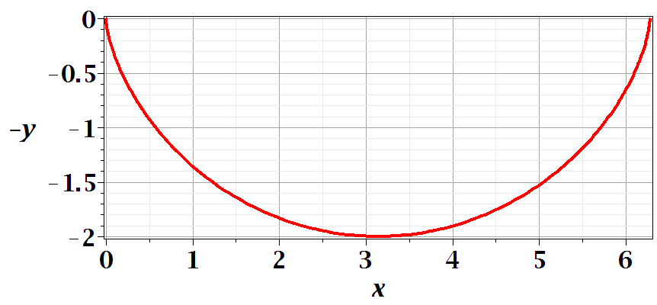
Comment on problem set #6
s

Slide 7
Comments on generalized coordinates:
Here we have assumed that the generalized coordinates
q_{σ} are independent. Now consider the possibility that the coordinates are related through constraint equations of the form:
Lagrange
multipliers

Slide 8
Simple example:
u
θ
y
x
θ

Slide 10
Rational for Lagrange multipliers

Slide 11
Euler-Lagrange equations with constraints:
Example:
r
θ
mg

Slide 12
Example continued:

Slide 13
Another example:

