Slide 1
PHY 711 Classical Mechanics and Mathematical Methods
10-10:50 AM MWF Olin 103
Plan for Lecture 1:
Welcome & overview
Class structure & announcements
Introduction to Maple software
Chapter 1 – scattering theory

Slide 2
Textbook:

Slide 3
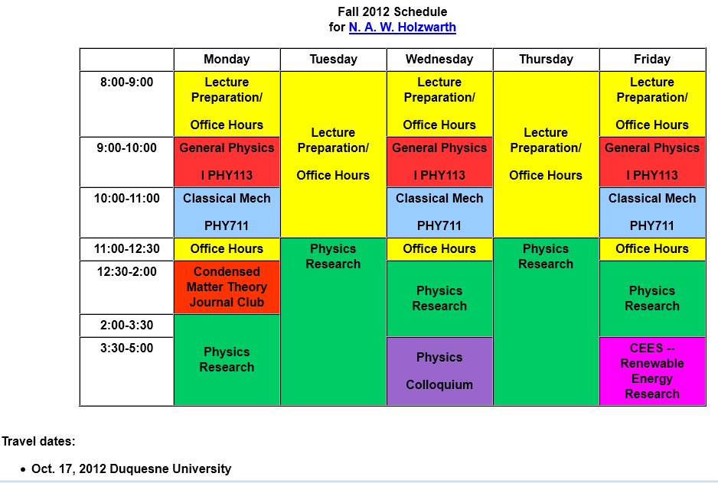

Slide 4
Comment about Physics Colloquia

Slide 6
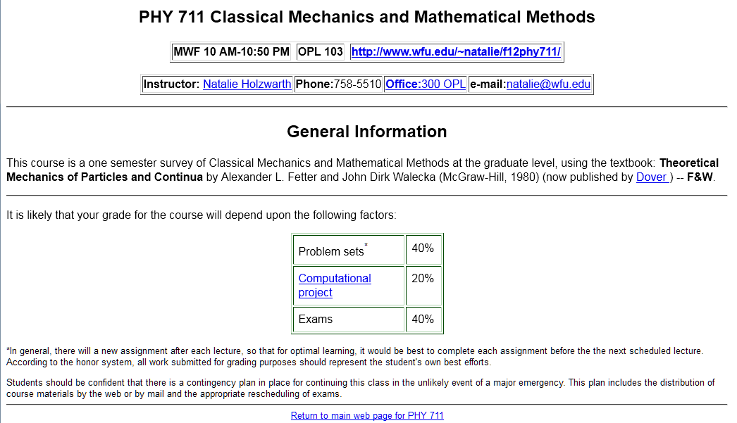

Slide 7
Introduction to algebraic manipulation software

Slide 8
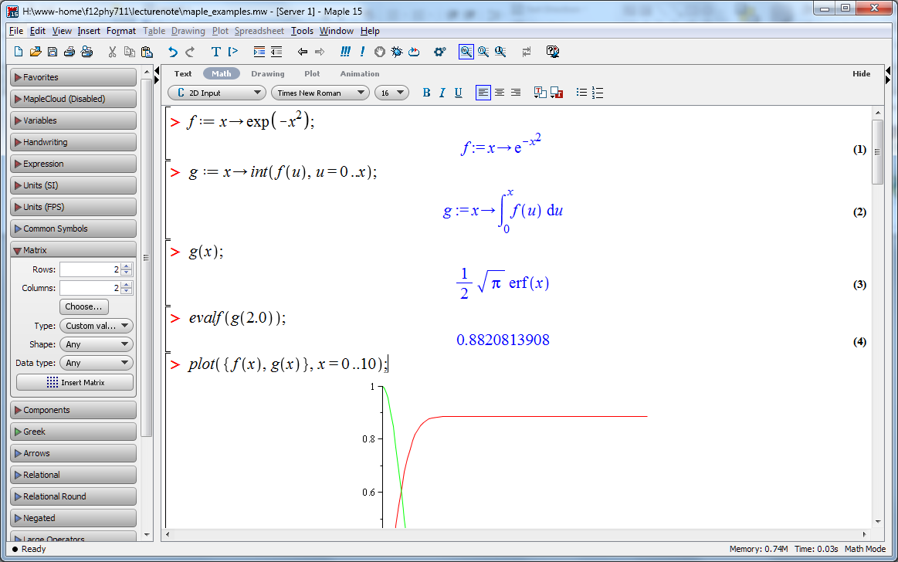
http://www.wfu.edu/~natalie/f12phy711/lecturenote/maple_example.mw

Slide 9
Scattering theory:

Slide 10
Figure from Marion & Thorton, Classical Dynamics

Slide 11
Differential cross section

