Slide 1
Flipped Classes: A Low-Stakes Opportunity for Problem
Rick Matthews, Jack Dostal

Slide 2
Flipped Learning is a pedagogical approach in which direct instruction moves from the group learning space to the individual learning space, and the resulting group space is transformed into a dynamic, interactive learning environment where the educator guides students as they apply concepts and engage creatively in the subject matter.
-- The Flipped Learning Network

Slide 3
Initial design goal
Push nearly all content delivery outside the classroom, freeing up contact time for interactive engagement.
Class contact time spent in interactive engagement has been proven to enhance understanding of physics concepts[Hake, Mazur].
To free up class time for more interactive activities, many alternatives have been designed that shift a significant portion of content delivery to outside of class. Examples: Just-in-Time Teaching[Novak, et al. 1999], Studio Physics[Wilson, 1994, Cummings, et al. 1999], SCALE-UP[Foote, et al. 2016], and flipped classes[Brame, 2013].

Slide 4
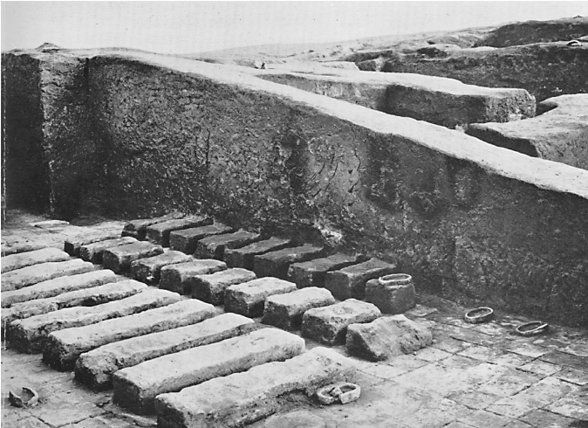
Interactive engagement works
Lots of different approaches, and they work.
The key to improved learning seems to be for students to actually apply physics concepts while together, not just act as scribes, passive receptors of content.
Classroom,
Ancient Sumer,
ca. 2000 BCE

Slide 5
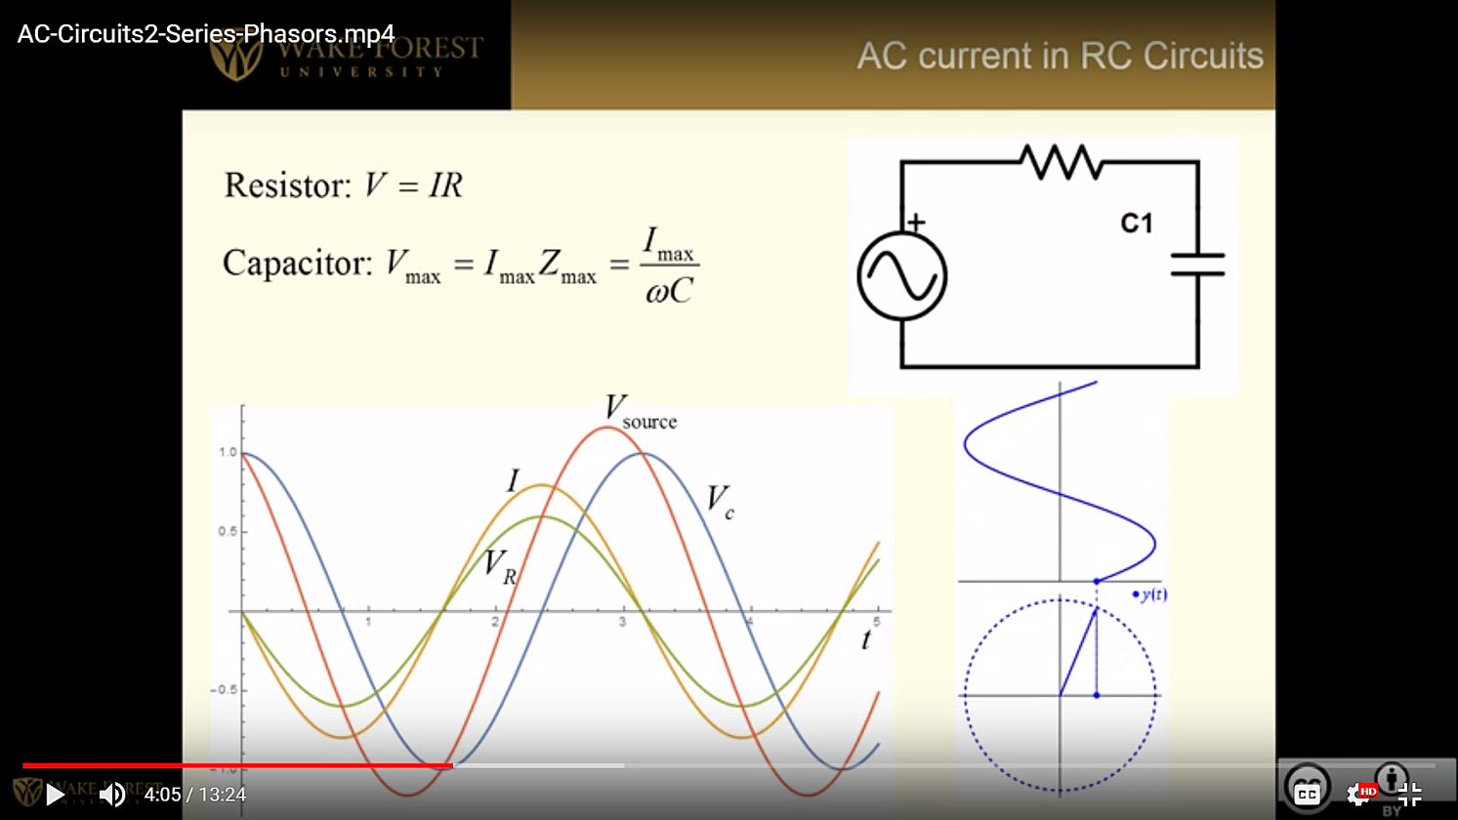
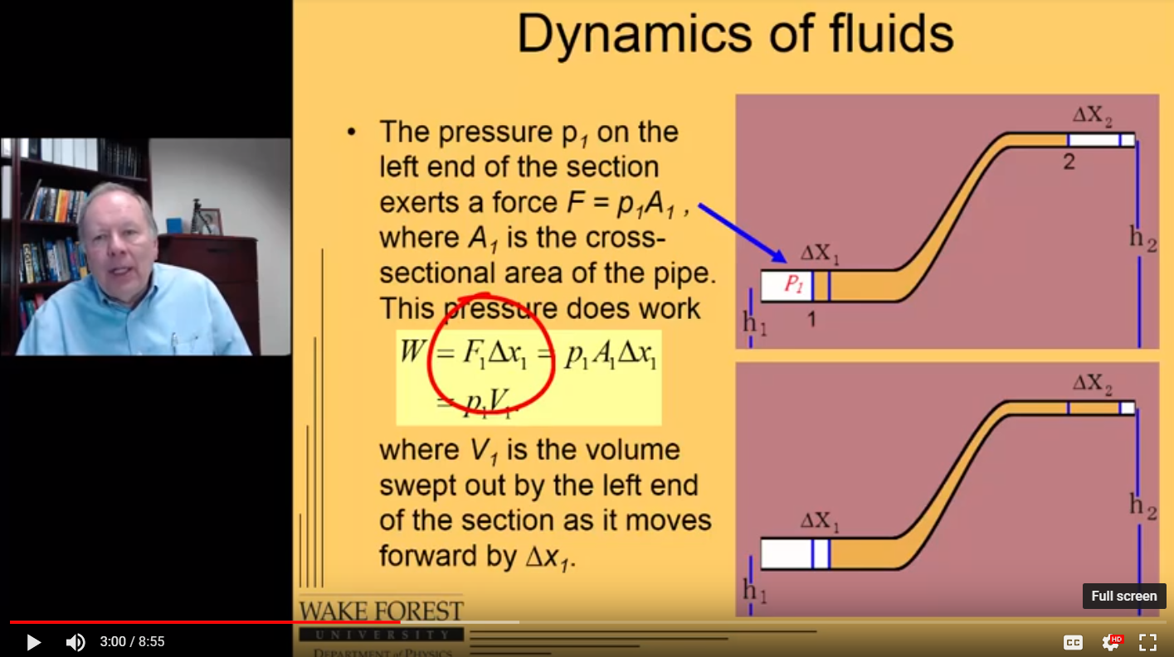
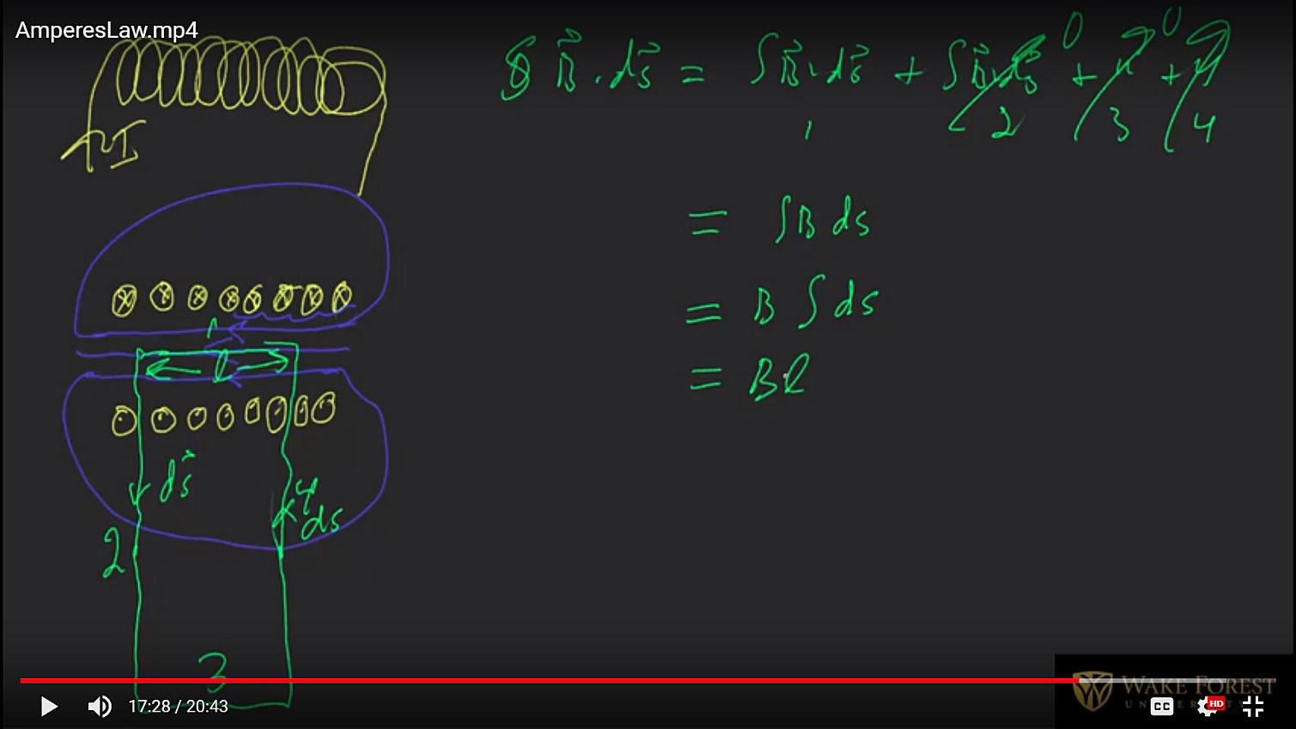
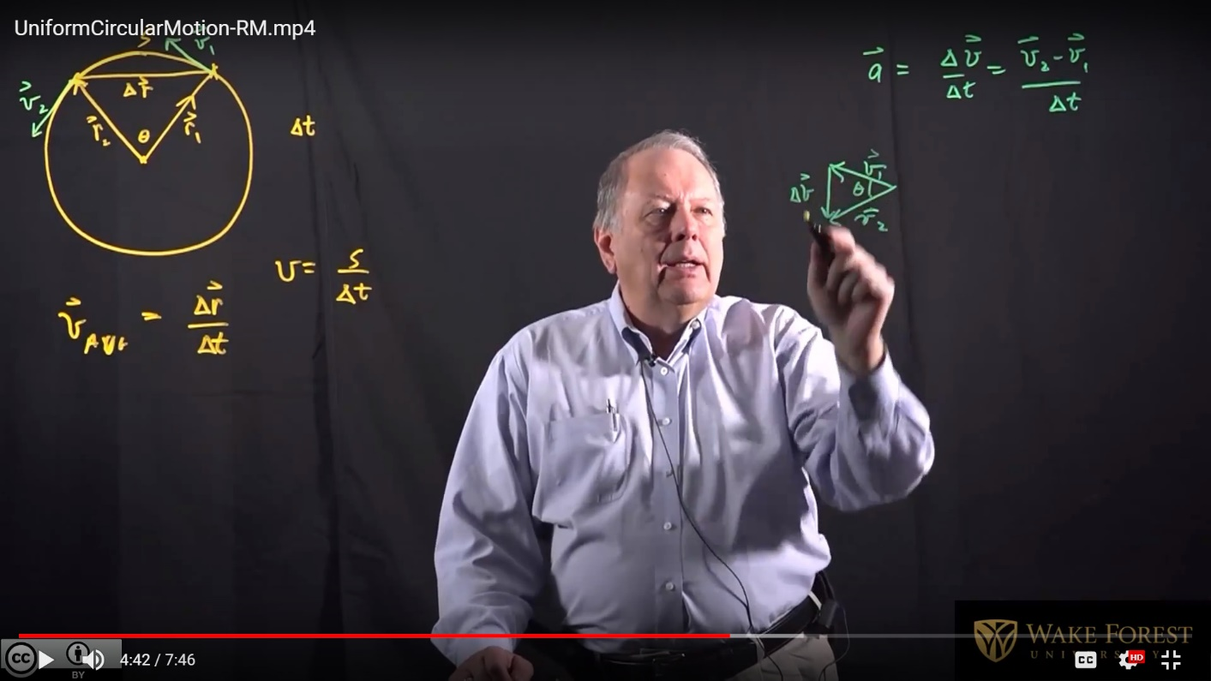
Lectures are via online videos
Notes:
We have experimented with many video lecture formats – narrated PPT, Talking head by PPT, Kahn-Academy-style writing on screen, and Lightboard.

Slide 6
Our flipped format
BEFORE CLASS
Online video lecture
Online problems:
Straightforward,
Automatically graded,
Due before next class
AFTER CLASS
Online problems:
Challenging,
Automatically graded,
Due a few days later.
CLASSTIME
Peer Instruction
Small group problem-solving
Notes:
The cycle.

Slide 7
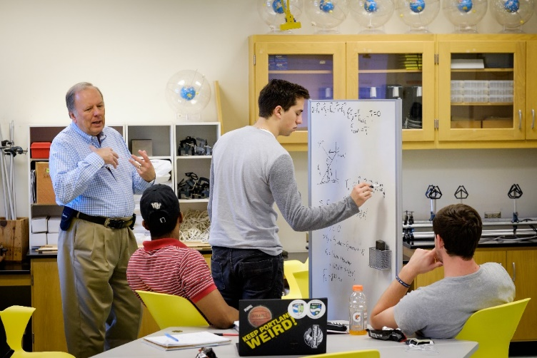
What happens in class
Small-group problem solving
Peer Instruction ConcepTests
A locomotive pulls a series of wagons. Which is the correct analysis of the situation?
1. The train moves forward because the locomotive pulls forward slightly harder on the wagons than the wagons pull backward on the locomotive.
2. Because action always equals reaction, the locomotive cannot pull the wagons the wagons pull backward just as hard as the locomotive pulls forward, so there is no motion.
3. ...
4. …
5. …
From “Peer Instruction,” E. Mazur, 1997
Problems from text
U. Washington Tutorials in Introductory Physics [McDermott, et al. and similar
Estimation
Spontaneous problems in response to student comments
Notes:
Class time alternates between Peer Instruction ConcepTest exercises and small-group problem solving.

Slide 8
A course design decision
No in-class activities (except hour tests) affect course grades.
Research on motivation:
Rewards diminish performance on cognitive tasks [Harlow, 1950][Pink, 2011]
Rewards diminish intrinsic interest in cognitive tasks [Pink, 2011] [Deci, 1976]
Class is the one time we can expect students to focus on problem solving without the external reward of grades.
Students are highly engaged in class!
Notes:
We find students are highly focused and work hard, even though their work does not affect their course grade.

Slide 9
Assessment: Student Self-Reported Learning
Less
Much more
About the same
More
Much less: 0%
Notes:
Students report learning more.

Slide 10
No
Yes
Notes:
Students wish other faculty would adopt this approach.

Slide 11
Assessment: Force Concept Inventory
One instructor taught five semesters of General Physics I, alternating traditional and flipped methodology.
Average normalized gain <g>:
Traditional: 0.19
Flipped: 0.42
Total number of students taking post-test
Traditional: 73
Flipped: 67

Slide 12
Summary
Moving content delivery to online lectures frees up class time for interactive engagement.
Nearly all students are highly engaged in class.
This approach provides a (unique?) opportunity for extensive problem-solving without the incentive of grades.
Students report high satisfaction with the flipped structure, and do not demand high production values on the lecture videos.
We see much improved gains on the Force Concept Inventory compared to traditional lecture-oriented classes.

