Slide 1
Chapter 4 Motion in Two Dimensions:
Reading assignment: Chapter 4.1, 4.2, 4.3
4.4 and 4.5 (angular acceleration) will be combined with chapter 6, skip 4.6
Homework: 4 (due Thursday, Sept. 20):
QQ3, AE1, AE4, 5, 7, 9, 20, 27, 62
In this chapter we will learn about kinematics (displacement, velocity, acceleration) of a particle in two dimensions (plane).
All four kinematic equations are still true, only in vector form
Superposition principle → treat vector components independently
Projectile motion

Slide 2
i-clicker
You travel in a train.
While standing in the station you throw an apple straight up by 20 cm.
After a while the train is traveling (horizontally) with a constant velocity of 30 m/s. You throw the apple straight up again by 20 cm.
In which situation will the apple be in the air longer? (Ignore air resistance).
A. Standing still
B. Traveling
C. The same time.
D. Need more information.
E. Depends on weight.

Slide 3
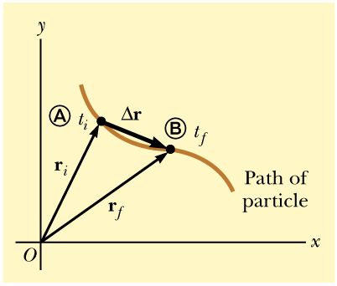
Displacement in a plane
The displacement vector r:
Displacement is the straight line between the final and initial position of the particle.
That is, the vector difference between the final and initial position.

Slide 4
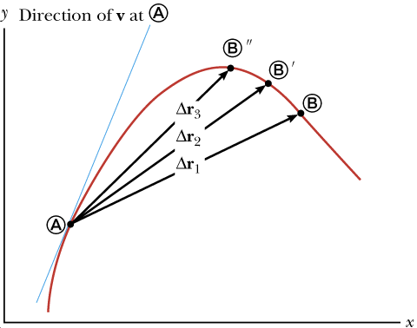
Average Velocity
Average velocity v:
Average velocity: Displacement of a particle, Δr, divided by time interval Δt.

Slide 5
Instantaneous Velocity
Instantaneous velocity v:
Instantaneous velocity v: Limit of the average velocity as Δt approaches zero.
The instantaneous velocity equals the derivative of the position vector with respect to time.
The magnitude of the instantaneous velocity vector
is called the speed (scalar)

Slide 6
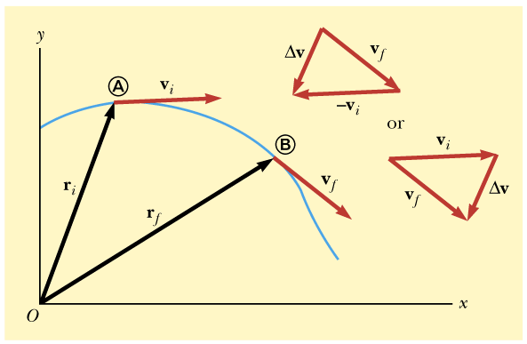
Average Acceleration
Average acceleration:
Average acceleration: Change in the velocity Δv divided by the time Δt during which the change occurred.
Change can occur in direction and magnitude!
Acceleration points along change in velocity Δv!
Quick quiz: Is it possible that a particle with constant speed experiences an acceleration?
A. Yes. B. No

Slide 7
Instantaneous Acceleration
Instantaneous acceleration:
Instantaneous acceleration: limiting value of the ratio
as Δt goes to zero.
Instantaneous acceleration equals the derivative of the velocity vector with respect to time.

Slide 8
Two-dimensional motion with constant acceleration a
Trick 1:
The equations of motion (kinematic equations) we derived before are still valid, but are now in vector form.
Trick 2 (Superposition principle):
Vector equations can be broken down into their x- and y- and z-components. Then calculated independently.
Position vector:
Velocity vector:

Slide 9
Two-dimensional motion with constant acceleration
Velocity as function of time:
Position as function of time:
Similarly, the other two kinematic equations are now in vector form (and can also be broken up into their x- and y-components:

Slide 10
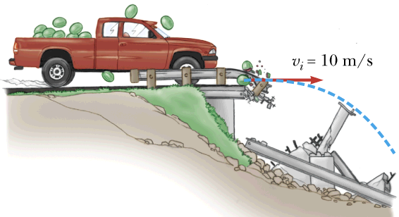
Black board example 4.1
A melon truck brakes right before a ravine and loses a few melons. The melons skid over the edge with an initial velocity of v_{x} = 10.0 m/s.
The melons hit the bottom of the ravine after 5 s.
Determine the x- and y-coordinates of the particle at any time t and the position vector r at any time t.
Determine the x- and y-components of the velocity at any time and the total velocity at any time.
Calculate the impact angle, the velocity and the speed of the melons as they hit the bottom of the ravine.

Slide 11
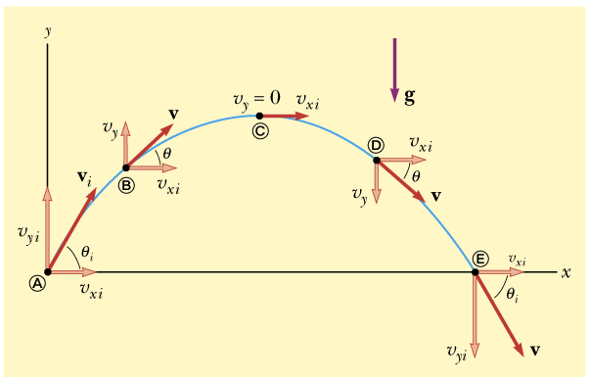
Projectile motion
Two assumptions:
Free-fall acceleration g is constant.
Air resistance is negligible.
The path of a projectile is a parabola (derivation: blackboard and see book).
Projectile leaves origin with an initial velocity of v_{i}.
Projectile is launched at an angle θ_{i}
Velocity vector changes in magnitude and direction.
Acceleration in y-direction is g.
Acceleration in x-direction is 0.

Slide 12
Projectile motion
Superposition of motion in x-direction and motion in y-direction
Acceleration in x-direction is 0. Acceleration in y-direction is g.
(Constant velocity) (Constant acceleration)

Slide 13
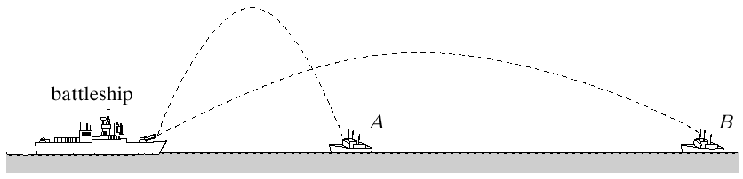
Quick quiz:
A battleship simultaneously fires two shells at enemy ships.
If the shells follow the parabolic trajectories shown, which ship gets hit first?
A.
B.
C. Both hit a the same time.
D. Need more information.

Slide 14
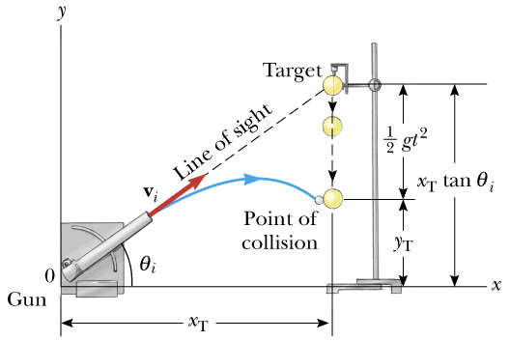
Hitting the bull’s eye of a simultaneously falling object.
Demo.

Slide 15
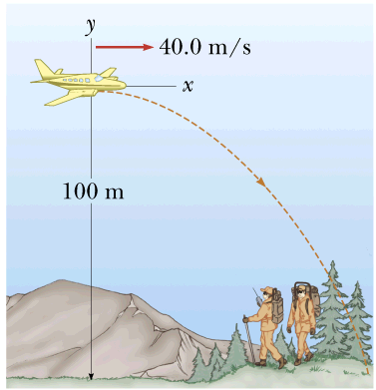
Black board example 4.2
A rescue plane drops a package to stranded explorers. The plane is traveling horizontally at 40.0 m/s and is 100 m above the ground.
Where does the package strike the ground relative to the point at which it was released.
What are the horizontal and vertical components of the velocity of the package just before it hits the ground? What is the speed of the package as it hits the ground?
Where is the plane when the package hits the ground? (Assume that the plane does not change its speed or course.)

Slide 16
i-clicker:
You shoot a bullet with 600 m/s straight at a fixed target that is 600 m away.
By how much does the bullet drop during its flight?
0 m
0.49 m
0.98 m
4.9 m
9.8 m
600 m
How do rifles correct for that?

Slide 17
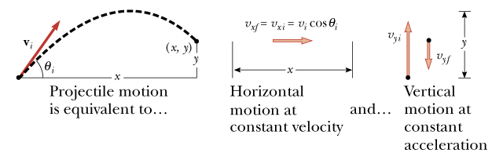
Quick review
Kinematics (displacement, velocity, acceleration) of a particle in two dimensions.
All four kinematic equations are still true, only in vector form:
Superposition principle → treat vector components independently!!
  → solve components independently, time connects equations for x- and y- components
Projectile motion:

Slide 18
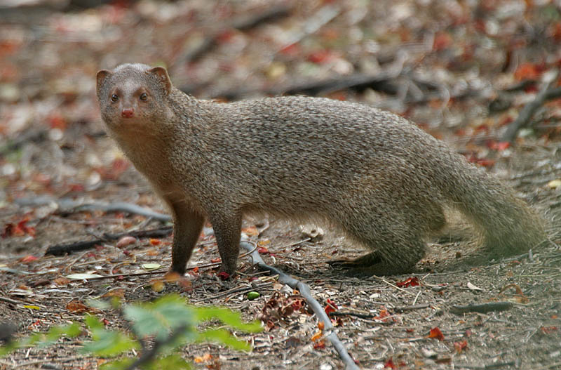
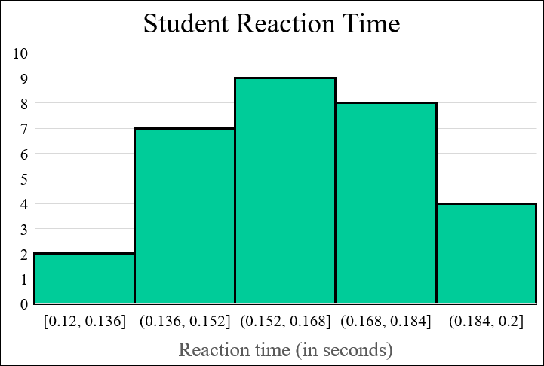
Avg.: 0.163 s
(13.0 cm)
Indian Gray Mongoose award (fastest reaction time)
So fast you could fight a snake:
Margaret Vaughan
Rich Pope

