Slide 1
Part 3 Thermodynamics
Chapter 20: Heat and the First Law of Thermodynamics
Reading assignment: Chapter 20.1 to 20.5, 20.7
Homework : (due Monday, June 30, 2003):
Problems: Chapter 19: 1, 14, 17, 28, 30
Chapter 20: 3, 5, 13, 20, 28
Chapter 20
Heat, specific heat
Internal energy
First law of thermodynamics

Slide 2
Heat and Temperature
Touching objects exchange thermal energy
Microscopically, energy flows both ways
On average, energy flows one way
Temperature predicts energy flow direction
Energy flows from hotter to colder
No flow → thermal equilibrium → same temp
Heat: Transfer of energy across the boundary of a system due to a temperature difference between the system and its surroundings.

Slide 3
Units of Heat
Since heat is energy transfer it has units of energy:
Joule (SI unit)
Also used:
1 calorie (1cal)
amount of energy to raise the temperature of 1 g of water from 14.4°C to 15°C
1 Calorie = 1000 calories
This unit is most often used in food (a sliver of cheese cake has 500 Calories).
1 cal = 4.186 J

Slide 4
When energy (heat Q) is added to a substance (and no work is done and no phase transition)
→ The temperature rises by ΔT.
By how much the temperature rises depends on:
- mass of substance, m
- type of substance
c… specific heat (material dependent) see Table 20.1)
C… heat capacitiy

Slide 5
Black board example 20.1
Problem 20. 3
21977 J of heat are transferred into 0.525 kg of water to raise its temperature by 10°C.
What is the specific heat of water?
1230 J heat are transferred into 0.525 kg of silver to raise its temperature by 10°C.
What is the specific heat of silver?

Slide 6
Conservation of energy when two bodies exchange heat:
The amount of heat flowing out of one body is the same as the amount of heat flowing into the other body.
Q_{cold} = - Q_{hot}
Blackboard Example 20.2
(Problem 20.5):
A 1.5 kg iron horseshoe (T = 600°C) is dropped into 20 liters (20 kg) of water (T = 25°C). What is the final temperature of the water (plus horseshoe)?

Slide 7
Latent Heat and Phase transitions
Whenever a substance undergoes a phase transition, energy is transferred into or out of the substance WITHOUT causing a change in temperature.
Common phase transitions:
Liquid to solid: freezing, latent heat of solidification
Solid to liquid: melting, latent heat of fusion
Liquid to gaseous: boiling, latent heat of vaporization
Gaseous to liquid: condensation, latent heat of condensation
Solid to gaseous: sublimation, latent heat of sublimation
Gaseous to solid: sublimation, latent heat of sublimation

Slide 8
Latent Heat and Phase transitions
The heat required to change the phase of a given mass m of a pure substance is:
L… latent heat
(see table 20.2 in book)
Blackboard example 20.3 (Problem 20.13):
What amount of energy (heat) is required to vaporize 100 g of water?
What amount of energy (heat) is required to melt 100 g of water?
A 3.00 g bullet at 30°C is fired into ice at 0°C at a speed of 240 m/s and becomes embedded. What quantity of ice melts?

Slide 9
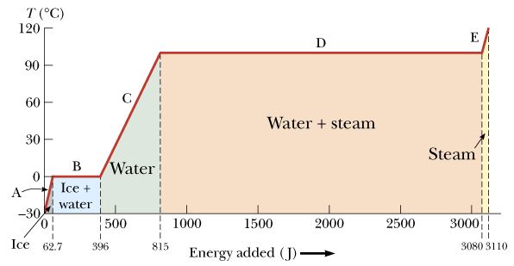
Latent Heat and Phase transitions
Energy required to convert 1 g of ice, initially at -30°C to steam at 120 °C.

Slide 10
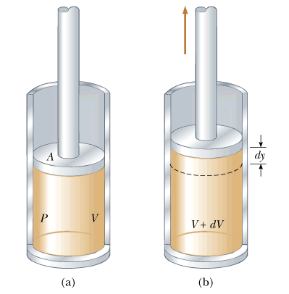
Work and Heat in Thermodynamic Processes
Work done by (or on) a gas:
Work = Area under P-V curve

Slide 11
If volume is decreasing, work is negative.
If volume is increasing, work is positive.
To evaluate this integral we need to know:
The initial and the final volume V_{i}, V_{f}
P as a function of V (P is often not constant).
→ Work does depend on the path taken!!

Slide 12
Reduce pressure from P_{i} to P_{f} at constant volume by cooling
Expand gas from V_{i} to V_{f} at constant pressure.
Expand gas from V_{i} to V_{f} at constant pressure.
Reduce pressure from P_{i} to P_{f} at constant volume by cooling.
Pressure and Volume change continuously at constant temperature.

Slide 13
Blackboard example 20. 4
Problem 20.20
Gas in a container is at a pressure of 1.50 atm and a volume of 4.00 m³. What is the work done by the gas
If it expands at constant pressure to twice its initial volume.
If it is compressed at constant pressure to one quarter of its initial volume?

Slide 14
The first law of Thermodynamics
(Generalization of Conservation of energy)
There are two ways to transfer energy between a system and its surroundings: Heat, Q & Work W.
The change in internal energy of a system is given by:
The internal energy of an ISOLATED system remains constant!
Note: Work done by system is positive; Work done on system is negative.
Heat into system is positive, heat out of system is negative.

Slide 15
Special process:
Closed cycle (beginning point is same as ending point).
ΔE_{int} = 0 → W = Q
In such a process, the work W done on the system is all converted into heat Q.

Slide 16
Special process:
Adiabatic process (No energy enters or leaves the system as heat)
Q = 0 → ΔE_{int} = – W
Examples:
Heat-insulated systems
Very fast processes, so that there is no heat exchange with environment.
Internal combustion machine (cars).
Diesel engines (trucks).
Fire syringe demo.

Slide 17
Special process:
Isovolumetric process (Process occurs at constant volume).
ΔV = 0 → W = 0 → ΔE_{int} = Q
P
i
Energy is added by heat to a system kept at constant volume.
Example: Sealed container in fire.
f
V_{i}
V_{f}
V
ΔE_{int} = Q

Slide 18
Special process:
Isobaric process (Process occurs at constant pressure).
ΔP = 0; W, Q and ΔE_{int} usually all change.
P
i
f
Gas expands from V_{i} to V_{f} at constant pressure P.
V_{i}
V_{f}
V
Work done by the gas:

Slide 19
Special process:
Isothermal process (Process occurs at constant temperature).
ΔT = 0
The internal energy of an IDEAL gas is a function of temperature only.
Thus, if ΔT = 0 → ΔU = 0
Work done on system, leaves system as heat.

Slide 20
Blackboard Example 20.28
Promblem 20.28
A gas is compressed from 9.00 L to 2.00 L at a constant pressure of 0.800 atm. In the process, 400 J of energy leaves the gas by heat.
What is the work done by the gas?
What is the change in its internal energy?

Slide 21
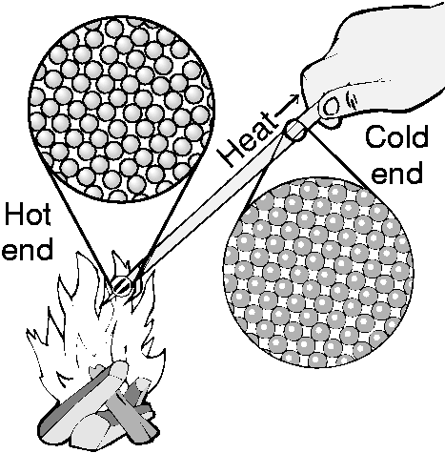
Three forms of heat transfer
All three transfer heat from hot to cold
Conduction
- heat flow through materials
2. Convection
- heat flow via moving fluids (air)
3. Radiation
- heat flow via light waves

Slide 22
Thermal Conductivity: The heat moves-not the atoms!
Examples:
___________________
___________________
___________________
Occurs only in connected or touching materials

Slide 23
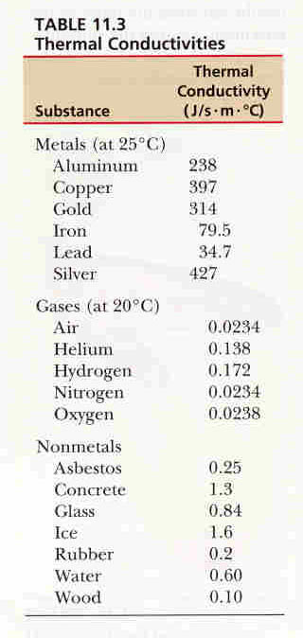
Thermal Conductivity depends on the material!
Best – metals
Middle – Insulators
Lowest - Gases

Slide 24
Conduction
Heat flows through material but atoms don’t
In an insulator,
adjacent atoms jiggle one another
microscopic exchanges of energy; atoms do work
on average, heat flows from hot to cold atoms
In a conductor,
mobile electrons help carry heat long distances
heat flows quickly from hot to cold via electrons

Slide 25
Convection: Hot atoms (molecules) move toward cold region carrying thermal energy with them!
Examples:
___________________
___________________
___________________
Convection cell

Slide 26
Convection
Fluid transports heat stored in its atoms
Fluid warms up near a hot object
Fluid flows away, carrying thermal energy with it
Fluid cools down near a cold object
Overall, heat flows from hot to cold
Natural buoyancy drives convection
Warmed fluid rises away from hot object
Cooled fluid descends away from cold object

Slide 27
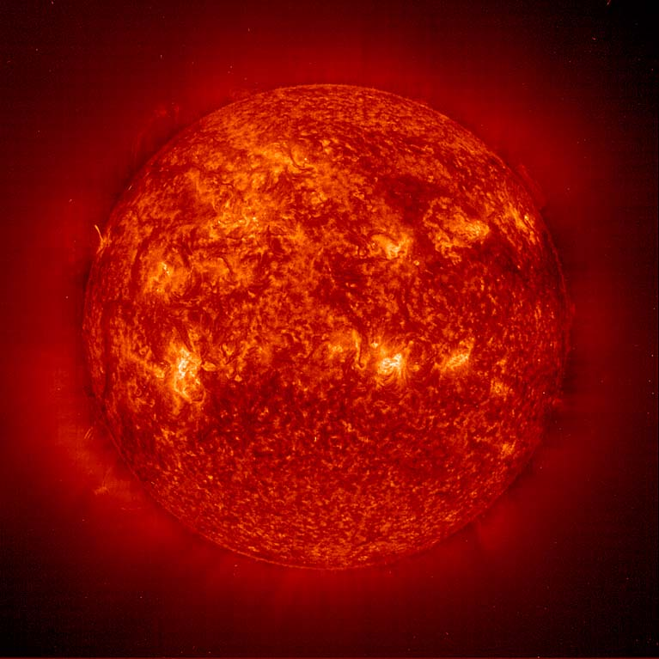
Radiation
Examples:
___________________
___________________
___________________
Heat transferred by electromagnetic waves (radio waves, microwaves, light, …)
Does not need a medium to travel!

Slide 28
Radiation
Heat transferred by electromagnetic waves (radio waves, microwaves, light, …)
Wave types depend on temperature
cold: radio wave, microwaves, infrared light
hot: infrared, visible, and ultraviolet light
Higher temperature → more radiated heat
Black emits and absorbs light best

