Slide 1
Announcements
Final exam
Monday, Dec. 10, 9:00 am – 12:00 pm (watch for weather-related announcements about alternative date!)
Comprehensive; chapters 1-18 (as far was we get, not standing waves in air columns); not chapter 11 (Angular Momentum) and not chapter 13 (Gravity)
Same format as midterms
Go through all exams and practice exams, HW, in class problems, concepts
Practice exams for material after midterm 2 are posted on class website http://users.wfu.edu/gutholdm/Physics113/phy113.html
Additional practice problems are posted on WebAssign
Review session, Sunday, Dec. 9, 4-6 pm
All grades are updated on class website

Slide 2
Part 2: Mechanical Waves
Chapter 18: Superposition and Standing Waves
Reading assignment: Chapter 18.1 to 18.5
Homework (due Friday, Dec. 7): OQ2, OQ4, OQ10, QQ5, 1, 2, 15, 20, 21, 23, (new, reduced assignment)
Took out (not assigned): OQ5, 3, 37, 39, 40, 44
What happens when waves interact with each other in the same medium?
Principle of superposition, standing waves.
This chapter: Mainly sinusoidal waves:
Musical instruments create standing waves.

Slide 3
Superposition and interference
If two traveling waves are moving through a medium, the resultant wave function is the algebraic sum of the wave functions of the individual waves.
Two traveling waves can pass through each other
When waves meet we can get constructive or destructive interference
Constructive interference
Destructive interference

Slide 4
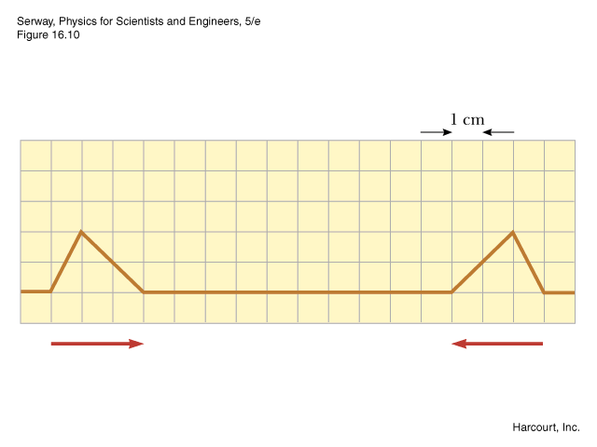
Black board example 18.1
Constructive interference
Two pulses are traveling toward each other at 10 cm/s on a long string as shown.
Sketch the shape of the string at time t = 0.6 s.
A)
C)
D)
E)
B)

Slide 5
Superposition principle
If two (or more) waves move in the same linear medium, the net resulting wave is equal to the algebraic sum of the two (or more) individual waves.
Constructive interference
Destructive interference:
Wave 1
Wave 2
Resultant wave

Slide 6
Superposition of two sinusoidal waves with the same wavevector, k, and angular frequency, ω.
One wave is shifted with respect to the other by a phase constant Φ.
Resultant wave:
New amplitude
Still a sine wave with same k and ω

Slide 7
Standing waves
Now we are considering two sinusoidal waves (same A, k and ω) that travel in the same medium, but in the opposite direction.
The resultant wave is a standing wave:
Nodes & antinodes
Just moving up and down
A standing wave is a an oscillating pattern with a stationary outline. It has nodes and antinodes.

Slide 8
Standing waves
A standing wave is a an oscillating pattern with a stationary outline. It has nodes and antinodes.
Nodes:
The nodes occur when sin(kx) = 0
Thus, kx = π, 2π, 3,π, …
antinode
antinode
node

Slide 9
Standing waves
A standing wave is a an oscillating pattern with a stationary outline. It has nodes and antinodes.
Antinodes:
The antinodes occur when sin(kx) = 1
Thus, kx = π/2, 3π/2, 5π/2, …
antinode
antinode
node

Slide 10
Standing waves
The distance between nodes is λ/2.
The distance between antinodes is λ/2
The distance between nodes and antinodes is λ/4
antinode
antinode
node

Slide 11
Black board example 18.2
Two waves traveling in opposite directions produce a standing wave. The individual wave functions are:
What is the amplitude of a particle located at an antinode?
Find the position of the nodes and antinodes.
What is the amplitude of a particle located at x = 2.3 cm.

Slide 12
Standing waves in a string fixed at both ends.
Normal modes of a string
Wavelength:
Frequency:
T … tension
μ … mass/length
f₁ is called the fundamental frequency
It depends on the length, mass and tension of the string

Slide 13
Standing waves in a string fixed at both ends.
f₁ is called the fundamental frequency
The higher frequencies f_{n} are integer multiples of the fundamental frequency
These normal modes are called harmonics.
f₁ is the first harmonic, f₂ is the second harmonic and so on…

Slide 14
String instruments:
When playing string instruments, standing waves (harmonics) are excited in the strings by plucking (guitar), bowing (cello) or striking (piano) them.
Black board example 18.3
A cello A-string vibrates in its first normal mode with a frequency of 220 Hz (A3). The vibrating segment is 69.0 cm long and has a mass of 1.90 g.
Find the tension in the string.
Determine the frequency of vibration when the string vibrates in three segments.
Why are some violins (and other instruments) so expensive (e.g.: Stradivarius, $1,500,000)?

Slide 15
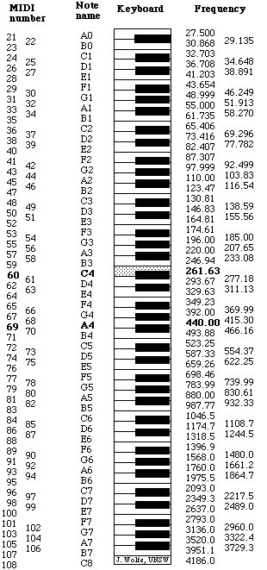
Notes and their fundamental frequency

Slide 16
Resonance
Oscillatory systems have one or more natural resonance frequencies.
When a periodic force, with a frequency equal to the resonance frequency, is applied to such a system the resulting motion is greater than normal (and can get very large!!)
Examples: Playground swing, oscillating string, musical instruments have a resonating body, glass shattered by singers, car rattling at a particular motor speed,….

Slide 17
Harmonics in a String
In a string, the overtone pitches are
Two, three, n times the fundamental frequency (octaves)
These integer multiples are called harmonics
Bowing or plucking a string tends to excite a mixture of fundamental and harmonic vibrations, giving character to the sound
Producing Sound
Thin objects don’t project sound well
Air flows around objects → Compression and rarefaction is minimal
Surfaces project sound much better
Air can’t flow around surfaces easily → Compression and rarefaction is substantial
Many instruments use surfaces for sound

Slide 18
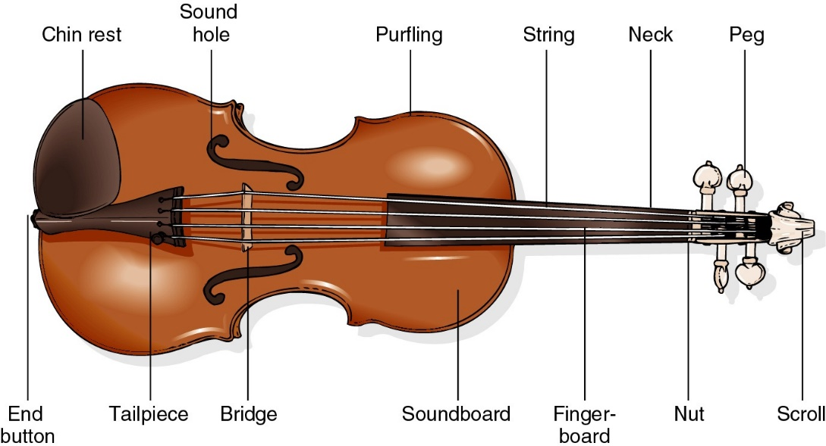
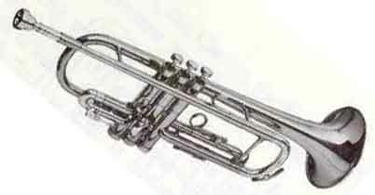
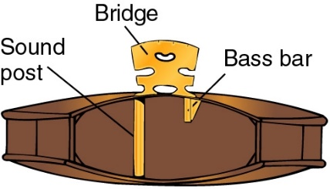
Music and Resonance:
Primary and secondary oscillators
strings
body
Mouthpiece
Air column &
instrument body
String Instruments
Wind Instruments
Connecting primary (strings) and secondary (body) oscillators

Slide 19
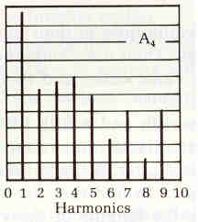
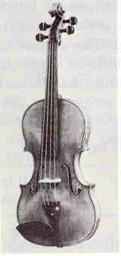
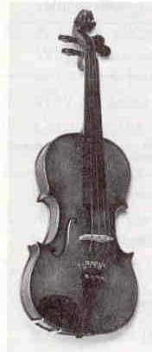
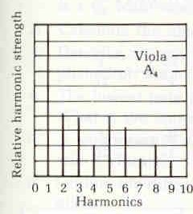
Violin Harmonics
Viola Harmonics

Slide 20
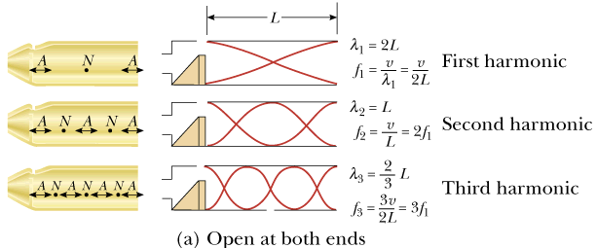
Standing waves in air colums
Standing waves can be set up in a tube or air (pipe, flute, …)
Distinguish between open end pipes and close end pipes
Analogous to standing waves on a string.
Antinode on open ends. Node on closed ends.
Both ends open:

Slide 21
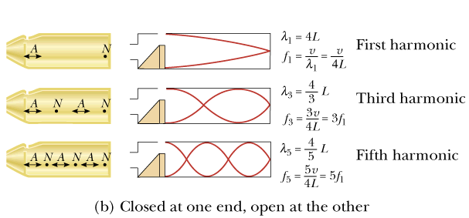
Standing waves in air colums
Antinode on open ends.
Node on closed ends.
One end closed:

Slide 22
In a pipe open at both ends, the natural frequencies of oscillation form a harmonic series that includes all integral multiples of the fundamental frequency
In a pipe closed at one end and open at the other, the natural frequencies of oscillation form a harmonic series that includes only odd integer multiples of the fundamental frequency.

Slide 23
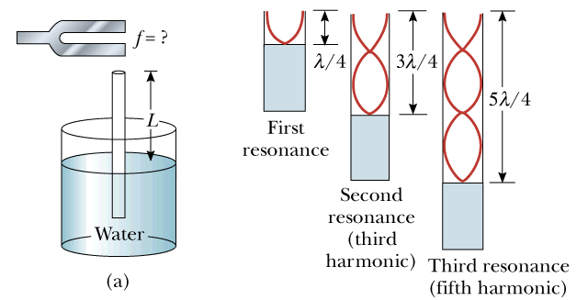
Demonstration of a standing wave in an air column
Black board example 18.4
A tuning fork is held above a column of air as shown. The smallest value for which a peak occurs in the sound intensity is 13.8 cm. (Assume: speed of sound in air is 343 m/s).
What is the frequency of the tuning fork?
What is the value of L for the next two resonance frequencies?

