Slide 1
Chapter 15: Oscillatory motion
Reading assignment: Chapter 15.1 to 15.5; 15.6 & 15.7 cursory
Homework 15 (due Wednesday, Nov. 28): QQ1, QQ2, QQ3, QQ4, QQ6, OQ1, OQ5, OQ7, OQ8, OQ10, OQ17, AE1, 4, 5, 8, 9, 19, 22, 27, 35, 46 (plus chapter 14, problem 42).
We’ll deal mainly with simple harmonic oscillations where the position of the object is specified by a sinusoidal function.
Mass on a spring
Energy
Pendulum

Slide 2
Simple harmonic motion/oscillation
Block attached to a spring
Motion of a swing
Motion of a pendulum (mathematical, physical)
Vibrations of a stringed musical instrument
Motion of a cantilever
Oscillations of houses, bridges, …
All clocks use simple harmonic motion
Piezoelectric (quartz) tuning fork from a wrist watch
(In a piezoelectric material, distortion creates voltage and vice versa)

Slide 3
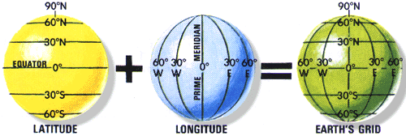
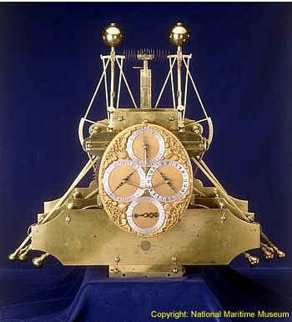
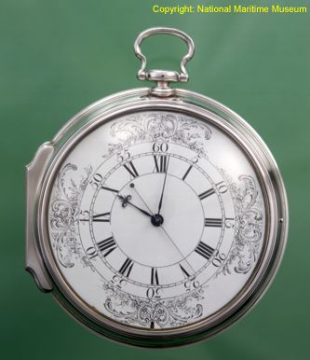
Brief Aside: The Importance of Time & The Longitude Problem
Determine local time through sun.
Compare with time (accurate clock!) at port of departure (London).
Each hour difference corresponds to 15º longitude (360º/24 hours).
Harrison’s H4 1759
Harrison’s H1 1735
http://www.rog.nmm.ac.uk/museum/harrison/longprob.html

Slide 4
Simple harmonic motion/oscillation
Restoring force:
F = - k·x
Acceleration:
Acceleration and restoring force:
proportional to x
directed toward the equilibrium position

Slide 5
Simple harmonic motion/oscillation
An object moves with simple harmonic motion whenever its acceleration is proportional to its displacement from some equilibrium position and is oppositely directed.
Solution to this 2nd order differential equation is:
or:

Slide 6
Properties of simple harmonic motion
Position of particle at time t:
A…amplitude
ω…Angular frequency
φ…phase constant, phase angle
→ shift by φ/ω
T…period, time to complete one full cycle
(ωt + Φ)…phase

Slide 7
Properties of simple harmonic motion
Displacement:
Period T:
Frequency:
Angular frequency:
Units: 1/s = 1 Hz
Velocity:
Acceleration:

Slide 8
Properties of simple harmonic motion
Displacement, velocity and acceleration vary sinusoidally.
Acceleration of particle is proportional to the displacement, but is in the opposite direction (a = - ω^{2·}x).
The frequency and period of the motion are independent of the amplitude. (demo).
Phase of velocity differs by π/2 or 90° from phase of displacement.
Phase of acceleration differs by π or 180° from phase of displacement.

Slide 9
The block-spring system
The frequency depends only on:
- the mass of the block
- the force constant of the spring.
The frequency does not depend on the amplitude.

Slide 10
i-clicker-1 & 2
You’re standing at the end of a springboard (obey’s Hooke’s law, like a spring), bouncing gently up and down without leaving the board’s surface (performing simple harmonic motion). If you bounce harder (larger amplitude), the time, T, it takes for each bounce will
become shorter
become longer
remain the same
How about if your friend walks up and bounces with you?

Slide 11
Black board example 15.1
A mass oscillates with an amplitude of 4.00 m, a frequency of 0.5 Hz and a phase angle of π/4.
What is the period T?
Write an equation for the displacement of the particle.
Determine the position, velocity and acceleration of the object at time t = 1.00s.
(d) Calculate the maximum velocity and acceleration of the object.

Slide 12
Black board example 15.2
i-clicker 3 & 4
A spring stretches by 3.90 cm when a 10.0 g mass is hung from it. A 25.0 g mass attached to this spring oscillates in simple harmonic motion.
Calculate the period of the motion.
0.63 s B) 1.00 s C) 1.43 s D) 2.44 s E) 3.14 s
(b) Calculate frequency of the motion.
A) 1.00 Hz B) 1.21 Hz C) 1.43 Hz D) 1.50 Hz E) 1.59 Hz

Slide 13
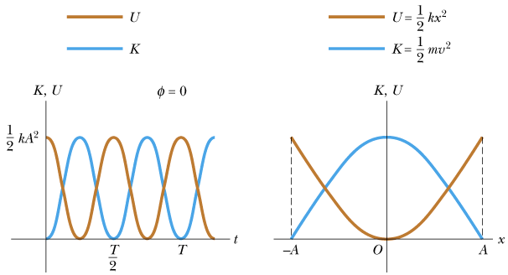
Energy of a harmonic oscillator
Kinetic energy:
Potential energy:
Total energy:

Slide 14
Black board example 15.3
A 0.200 kg mass is attached to a spring and undergoes simple harmonic motion with a period of 0.250 s. The total energy of the system is 2.00 J.
What is the force constant of the spring?
What is the amplitude of the motion?
What is the velocity of the mass when the displacement is 8.00 cm?
What is the kinetic and potential energy of the system when the displacement is 8.00 cm?

Slide 15
The physical pendulum
For small angles (less than about 10°)
Small angle approximation: sinθ ~ θ
I… moment of interia
m… mass of object
g… acceleration due to gravity
d… distance from pivot point to center of mass

Slide 16
The (mathematical) pendulum (point mass)
For small motion (less than about 10°).

Slide 17
Black board example 15.4
Find the period of a tennis ball swinging on a 4 m) long string
A) 2.0 s B) 2.2 s C) 3.0 s
D) 3.4 s E) 4.0 s

Slide 18
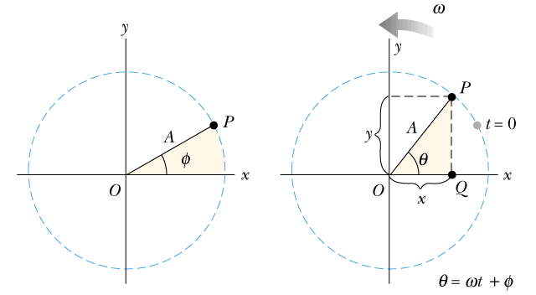
Simple harmonic motion and uniform circular motion

Slide 19
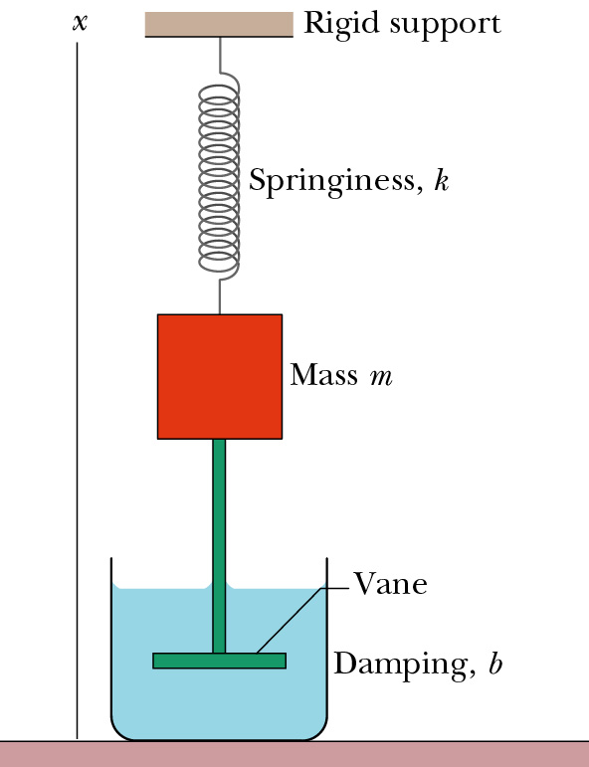
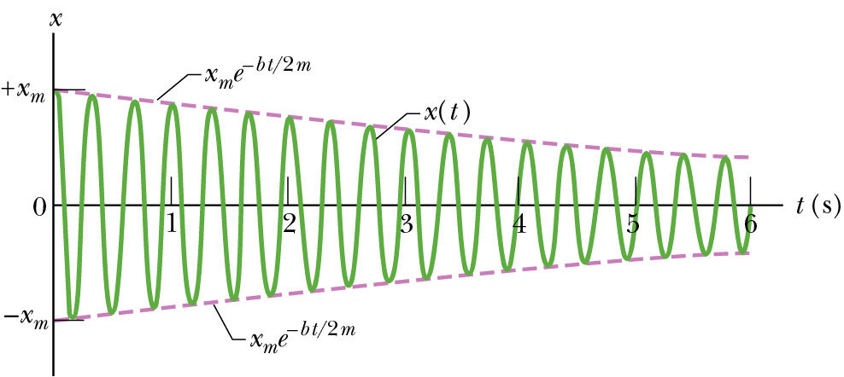
Damped, simple harmonic motion
Spring constant, k
b is damping constant

Slide 20
Forced (Driven) Oscillations and Resonance
b is damping constant
A damped, harmonic oscillator (ang. frequency ω) is driven by an outside, sinusoidal force with ang. frequency ω_{d}
→ Resonance when ω_{d} = ω (can get very large amplitudes)

