Slide 1
Announcements:
Midterm 2 coming up Monday Nov. 12 , (two evening times, 5-6 pm or 6-7 pm), Olin 101.
Material: Chapters 6 – 14 (through HW 14.1 (pressure)).
I’ll provide key equations (last page of exam).
You are allowed to use a non-programmable calculator
I will put practice exams on our class web page (http://www.wfu.edu/~gutholdm/Physics113/phy113.html)
I’ll also update all grades by tomorrow

Slide 2
Chapter 12: Static Equilibrium and Elasticity
Reading assignment: Chapter 12.1 to 12.4
Homework 12 (due Thursday, Nov. ):
QQ1, QQ3, OQ2, OQ9, AE2, 3, 10, 11, 33, 28, 39, 49
Objects in static equilibrium don’t move, F_{net} = 0, τ_{net} = 0
Important for posture of human body, biomechanics.
Important civil and mechanical engineers and architects.
We’ll also learn about elastic (reversible) deformations.
Plastic deformations are irreversible (like play dough).

Slide 3
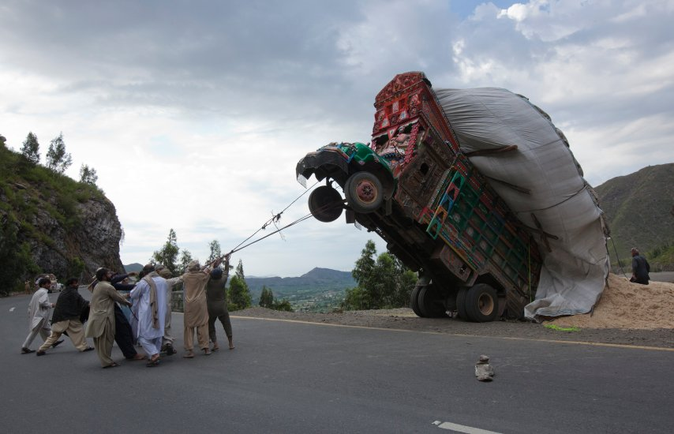
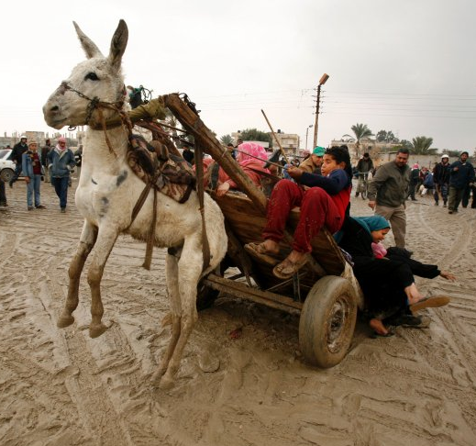
… was not in static equilibrium

Slide 4
Conditions for static equilibrium
Objects in static equilibrium don’t move or rotate.

Slide 5
Conditions for static equilibrium
(For extended objects)
The net force acting on the particle must be zero.
The net torque about any axis acting on the particle must be zero.
The angular and linear speeds must be zero.
We restrict ourselves to forces in the x-y plane. Thus:

Slide 6
How do we treat the gravitational force?
Center of gravity
Consider an extended object.
The gravitational force mg always acts on the center of gravity!
The center of gravity is equal to the center of mass (see Chapter 9) (unless gravity is not uniform)

Slide 7
Problem-solving approach:
Objects in static equilibrium. (we will only consider objects that are homogeneous, symmetric, and in a uniform gravitational field.)
Draw a free body diagram.
Show and label all the external forces acting on the object.
Indicate where the forces are applied.
Establish a convenient coordinate system for forces. Then apply condition 1: Net force must equal zero.
Establish a convenient coordinate system for torque (pick convenient pivot). Then apply condition 2: Net torque must equal zero.

Slide 8
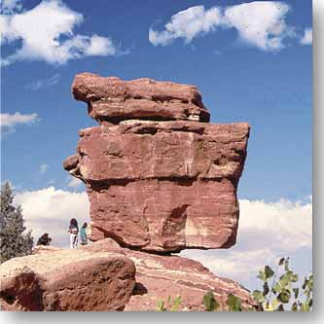
Black board example 12.1
Balanced Rock
(Garden of the Gods, Colorado Springs)
For this system to be in static equilibrium, the center of gravity must be over the support point.

Slide 9
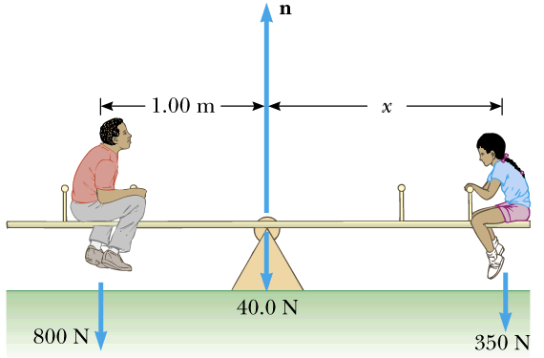
Black board example 12.2
A uniform 40.0 N board supports a father (800 N) and daughter (350 N) as shown. The support is under the center of gravity of the board and the father is 1.00 m from the center.
Determine the magnitude of the upward force n exerted on the board by the support.
Determine where the child should sit to balance the system.

Slide 10
Upper arm
Black board example 12.3
Biceps
Under arm
10 kg
You are holding a 10 kg mass as shown schematically in the picture. Your underarm (of negligible mass) is 0.5 m long, and your biceps muscle attaches to the underarm at 0.05 m from the elbow joint. With what force is your biceps muscle pulling on the underarm bone?
A) 10 N B) 98 N C) 490 N D) 980 N 4900 N

Slide 11
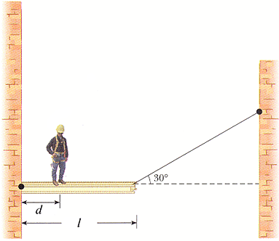
Black board example 12.4
A person with weight 700 N stands d = 4.00 m away from the wall on a l = 10.00 m beam, as shown in this figure. The weight of the beam is 3000 N.
(a) Find the tension in the wire. (b) Find the horizontal component of the hinge force. (c) Find the vertical component of the hinge force (homework).

Slide 12
Elastic properties of solids
We will consider three types of deformations and define an elastic modulus for each.
Change in length. YOUNG’S MODULUS measures the resistance of a solid to a change in its length.
Shearing. SHEAR MODULUS measures the resistance to shearing.
Change in volume. BULK MODULUS measures the resistance to changes in volume.

Slide 13
Elastic properties of solids
Definitions of stress and strain.
Stress: Force per unit cross sectional area.
Strain: Measure of the degree of deformation.

Slide 14
Elastic properties of solids
Young’s modulus:

Slide 15
Elastic properties of solids
Shear modulus:

Slide 16
Elastic properties of solids
Bulk modulus:
P… pressure

Slide 17
Black board example 12.5
A 200 kg load is hung on a wire with a length of 4.00 m, a cross-sectional area of 2.00·10⁻⁵ m and a Youngs modulus of 8.00·10¹⁰ N/m².
What is its increase in length?

Slide 18
