Slide 1
PHYISCS 113 SYLLABUS
Physics 113 – Fall 2018
Prof. Martin Guthold
Office: Olin 302, Lab: Olin 202
Phone: 758-4977 (office), 608-7304 (cell)
Home: 923-9902
e-mail: gutholdm@wfu.edu
OFFICE HOURS
Mo, We, Fr, 1:00-2:00 pm, 302 Olin
Feel free to drop by any time and I’ll try to accommodate you.
Physics 113 is the first course in a two-semester sequence in calculus-based general Physics. It does require the use of calculus and some vector calculations. (Calculus (Math 111) and Physics 113 may be taken at the same time).
SCHEDULE
Lectures: Tuesday, Thursday, 12:30 pm – 1:45 pm; room Olin 101
Labs:
All students must also enroll in one laboratory session. Labs will begin next week (week of Sept. 3); room Olin 104; no lab Thanksgiving week.
Labs cannot be made up on other days.
Attendance in the labs is required.

Slide 2
TEXT AND MATRIALS
Required text book: Serway & Jewett, Physics for Scientists and Engineers, 9th or 10th edition, vol. 1; earlier editions (6th, 7th, or 8th) are ok. Physics 114 will use vol. 2.
Required: Sign up for WebAssign (~$100 (includes e-book), more details below).
    WebAssign & e-book are best deal
Required: For the lab you must get the lab manual from the bookstore (~$15)
Required: i-clickers (bookstore (~$30, new) or REEF app on cell phone (~$15 for months), can be used for other classes)
Optional: Student solution manual (can help with some homework problems)
EXAMS AND GRADING
There will be one, comprehensive, 3-hour final exam and two1-hour, evening midterm exams given at the dates listed below. Homework problems will be assigned for each chapter and they will be also be graded.
1. Exam 20 %
2. Exam 20 %
Final Exam 30 %
Lab 15 %
Homework 10 %
i-clickers 5%
Participation can move borderline grades.
Exams:
Exam 1: Monday, Oct. 1, 5:00 – 6:00 pm or 6:00 – 7:00 pm (Chapters 1-6)
Exam 2: Monday, Nov. 12, 5:00 – 6:00 pm or 6:00 – 7:00 pm (Chapters 7-14)
Final: Monday, Dec. 10, 9:00 am – 12:00 pm (comprehensive, Chapters 1-21)

Slide 3
HOMEWORK AND PROBLEM SOLVING
Homework and problem solving is an important part of learning in a Physics course. Approximately 10-15 questions or problems per chapter will be assigned as homework. We will use WebAssign. Homework is usually due one or two lectures after it has been assigned. No late homework is accepted. Some homework problems may also re-appear on the exams and the final. You may collaborate on homework, but must submit your own work.
POSTINGS
Homework, practice exams, all lecture notes and all other material relating to the course will be posted on the web site for the class:
http://www.wfu.edu/~gutholdm/Physics113/phy113.html
To get ready for class: Print out lecture notes before class and bring to class.
This class does not use CourseInfo or Blackboard.
WebAssign (http://www.webassign.net/) will be implemented for standard homework assignments. You have nine attempts to get the answers right (Demo follows). Access codes to WebAssign (~$100, includes e-book) need to be purchased from the bookstore or WebAssign.
ATTENDANCE
It is expected that students attend all scheduled classes. Attendance at the two exams and the final is required. Absence on the exams will result in a zero grade unless an official excuse is presented. Excuses should be reported to me in advance.
i-clicker gives one point for attendance, one point for each correct answer.

Slide 4
Lecture format:
Demos: Understand them &
and take notes.
(May pop up in exam)
Powerpoint presentations
download from http://www.wfu.edu/~gutholdm/Physics113/phy113.html, print out (e.g. three slides on a page) and bring to lecture.
Whiteboard examples
i-clickers: Concept questions and quick quizzes with immediate feedback.

Slide 5




iclicker notes
Two options:
Purchase handheld i-clicker device (new or used) in bookstore
Or: Download iclicker REEF app onto your phone as outlined on this webpage (need to open an account):
https://www1.iclicker.com/products/reef-polling/
Will get free demo trial for two weeks, then pay for subscription (6 months $14.99; or longer)
If you already have a REEF account, use it!
Add course: Institution: Wake Forest University; Our class is “Physics 113C (Guthold-3)”.
Notice the -3 behind my name!
I accidentally created several Physics 113C classes. Only use the one with the -3 after Guthold!!

Slide 6
Labs
- The labs take place in Olin 104
Lab manager:
  Eric Chapman (Olin 110), phone: 758-5532
Your lab teaching assistants (TAs):
  Taylor Ordines, Daniel Vickers, Robert Link, Shoreh Gholizadeh
Need to buy lab manual
Labs start next week (week of Sept. 3) (no lab Thanksgiving week)

Slide 7
PHY113 TUTOR SESSIONS
Sunday | Monday | Tuesday | Wednesday | Thursday | Friday | Saturday
Tutors and times – to be announced shortly
The tutor sessions in semesters past were very successful and received high marks from many students.
All students are encouraged to take advantage of this opportunity.

Slide 8
Pandemic Plan
In case of pandemic or major disaster striking the University (University closing, or instructor unavailable):
Tiered plan:
  Class might be covered by other instructor (if available).
  The lecture notes (ppt slides) will be distributed to you via the class web page, e-mail or regular mail.
  Short movies covering the major points may be posted on the class web page.
  You may be given a CD or DVD with all the lecture notes and exams to be taken.
  Exams will be taken on the dates indicated in the syllabus. Exams will be taken in a location to be announced or will be sent to you via web page, e-mail or regular mail.

Slide 9
Material covered in this class
(Chapters 1-21, Serway & Jewett “Physics for Scientists and Engineers”, 9th ed.)
Mechanics
Physics & Measurement
Motion in 1-D
Vectors
Motion in 2-D
Laws of Motion (Newton’s laws)
Circular Motion
  Exam 1 (chapters 1 through 6)
Energy of a System
Conservation of Energy
Linear Momentum & Collison (brief)
Rotation of a rigid object about a fixed axis (brief)
Angular Momentum (brief)
Static Equilibrium and Elasticity
Universal Gravitation (brief)
Fluid Mechanics
  Exam 2 (chapters 7 through 14)
Oscillations & Waves
Oscillatory Motion
Wave Motion
Sound Waves
Superposition and Standing Waves (brief)
(Intro) Thermodynamics
Temperature
1. Law of Thermodynamics (brief)
Kinetic Theory of Gases
  Final exam (comprehensive)
  The covered material closely matches the MCAT requirements
On average, we’ll spend about 100 minutes/chapter.

Slide 10
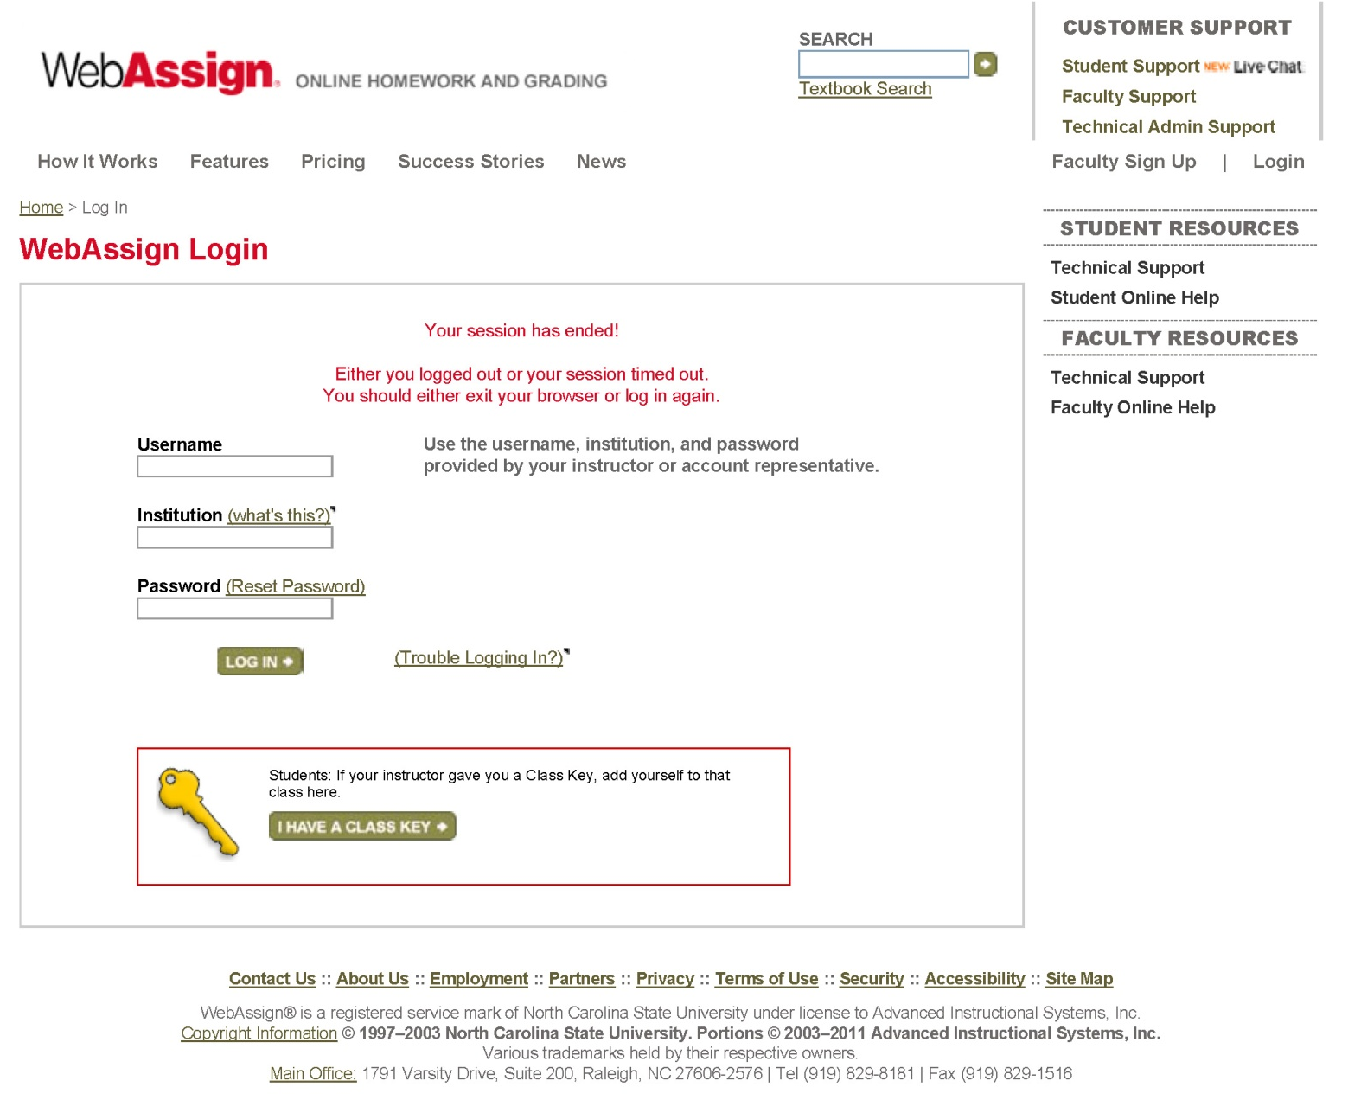
A few slides about WebAssign: Log-in
Your e-mail address: e.g. gutholdm
wfu
Set your own password
(initial password WFU[student ID]
e.g. WFU01060309
Some students who already have accounts should be able to re-use them (but still need to pay for each class

Slide 11
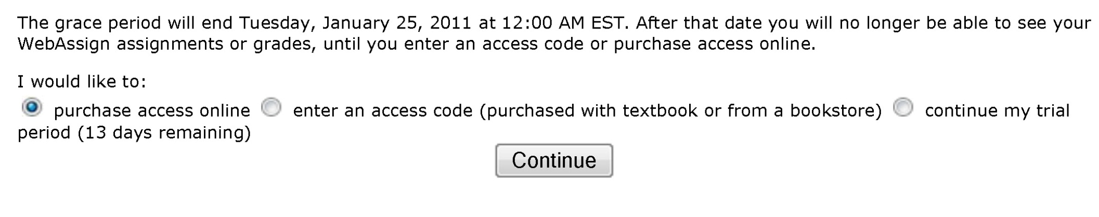
A few slides about WebAssign: What to purchase
There are two options to purchase WebAssign:
Purchase access code.
Enter access code (purchased with textbook from bookstore).

Slide 12
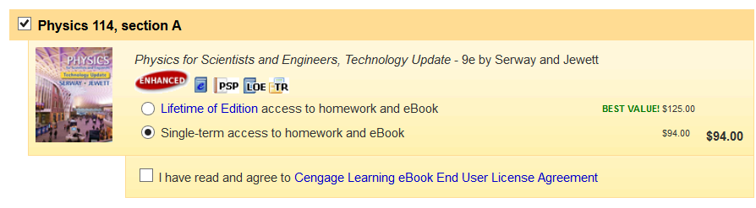
A few slides about WebAssign: What to purchase
Options:
Buy access code with hardcopy book.
Lifetime of Edition (LOE). Homework and eBook. You are allowed unlimited access to WebAssign courses that use this edition of the textbook. ($125)
Single term access. Homework and eBook.
($94)
The e-book is basically just a nice electronic version of the book. You only need the hard copy textbook or the eBook (not both).

Slide 13
A few slides about WebAssign: What to purchase
Notation (use scientific notation):
2.32‧10⁻⁴ → 2.32e-4 (in WebAssign)
Need to use three significant figures (unless otherwise stated).

Slide 14
Part 1: Mechanics
Concerned with the motion of objects (larger than atoms (quantum effects); significantly slower than speed of light (relativistic effects))
Motion of bodies, such as planets, rockets, cars, balls,…
Conservation of energy
Collisions, conservation of momentum
Rotation, conservation angular momentum
Oscillations & Waves

Slide 15
Chapter 1: Physics and Measurement
Reading assignment: Chapter 1, get ready for Chapter 2
Homework 1 (due: Tuesday, Sept. 4, 11:59 pm):
Problems: 12, 20, 33, 35, 36
  Do all the homework on WebAssign, no need to turn in papers, keep your papers and calculations to review and study for exams!!
  The problem numbers refer to the 9th edition of Serway & Jewett
Sign up (purchase access code) and check out WebAssign: http://www.webassign.net/
Purchase i-clicker, book, lab manual

Slide 16
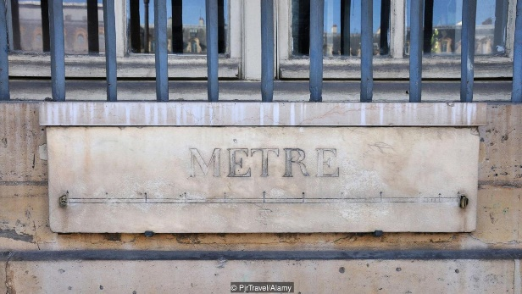
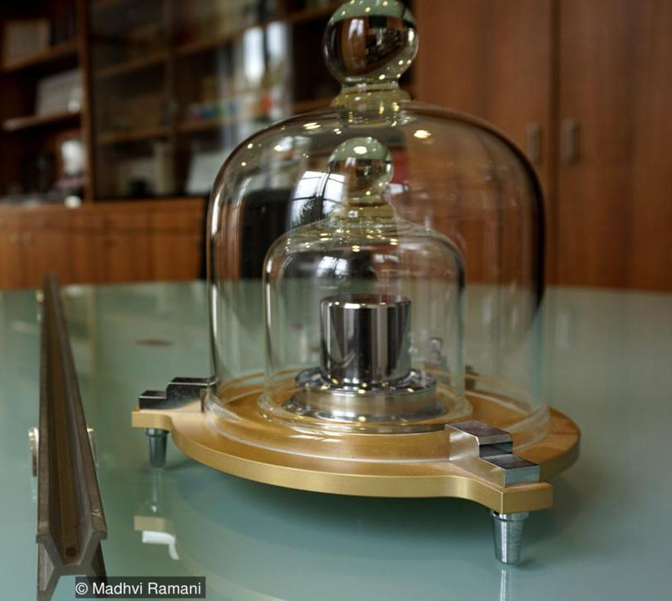
Units
In mechanics the three basic quantities are:
Length (we will use the unit meter; 1 m)
Was defined as 1/10,000,000 distance of pole to equator. Standard meter was cast from metal alloy.
Now, the length of the path travelled by light in vacuum during a time interval of 1/299 792 458 of a second.
Mass (we will use the unit kilogram; 1 kg)
Time (we will use the unit second; 1 s)
And combinations of these units (e.g. unit of velocity: m/s)
These are units of the SI (Système International d'unités) system that is used throughout the world in the Sciences.
One of the last remaining ‘mètre étalons’, or standard metre bars placed around Paris (200 total).
The original standard meter and standard kilogram housed in The International Bureau of Weights and Measures (BIPM), Paris.
The system was introduced after the French Revolution (1789) and took about 100 years before almost all French people used it.

Slide 17
Changing units
We need to apply conversion factors (a ratio of units that are equal to one) to get the right units
Black board example 1.1
A faucet puts out water at 10.00 ft³/minute.
How many seconds will it take to fill a 1.00 m³ bath tub?
See appendix for conversion factors
(1 m = 3.281 ft)

Slide 18
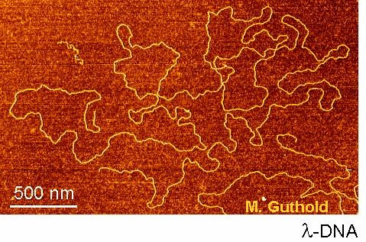
Factor | Name | Symbol
10²⁴ | yotta | Y
10²¹ | zetta | Z
10¹⁸ | exa | E
10¹⁵ | peta | P
10¹² | tera | T
10⁹ | giga | G
10⁶ | mega | M
10³ | kilo | k
10² | hecto | h
10¹ | deka | da
The 20 SI prefixes used to form decimal multiples and submultiples of SI units (from NIST).
Black board example 1.2
DNA has a diameter of 2‧10⁻⁹ m. How many nanometer is that?
10⁻¹ | deci | d
10⁻² | centi | c
10⁻³ | milli | m
10⁻⁶ | micro | µ
10⁻⁹ | nano | n
10⁻¹² | pico | p
10⁻¹⁵ | femto | f
10⁻¹⁸ | atto | a
10⁻²¹ | zepto | z
10⁻²⁴ | yocto | y

Slide 19
Dimensional analysis
Dimensions (In this case we mean the units of a physical quantity) can be treated as algebraic quantities.
Always do a dimensional analysis when solving problems.
Black board example 1.3
Newton's law of universal gravitation is represented by the following equation.
F = (GM₁M₂) /R²
  Here F is the gravitational force, M₁ and M₂ are masses, and R is a length. Force has the SI units kg · m/s². What are the SI units of the proportionality constant G?

Slide 20
Problem solving:
Always make sure you use the right units (conversion may be necessary)!
Always do an order of magnitude estimation. Ask yourself: “Does the number I’m getting make sense?”

Slide 21
Significant figures and propagation of uncertainty
A significant figure is a reliably known figure.
Give answers in significant figures. → black board examples.
When adding or subtracting numbers, the number of decimal places in the result should equal the smallest number of decimal places of any term in the sum.
When multiplying several quantities, the number of significant figures in the final answer is the same as the significant figures in the least accurate of the quantities being multiplied. (Same for division)
For WebAssign you need to be within 5% of the correct answer.

